Slide 1
CI/CD Pipeline Project
By Michael Hajjar

Slide 2
What is CI/CD
CI/CD stands for Continuous Integration/Continous Delivery and/or Deployment. A team that does not implement CI/CD will have to pass through the following stages when it creates a new software product:

Slide 3
Why we use this?
Product Manager gives details on what he/her wants
Developers Start to write code, testing it and commit it to a version control system
Sent to QA where tests are done against the code to find bugs and sent back to developers if detected
Once QA is done, code is deployed to production by development teams

Slide 4
Automation Initial Notes
Minikube creates kubernetes cluster
Yaml configuration file for Kubernetes in jenkins
Docker file
Delete everything, 1 command will reset everything
Vagrant creation file creates the virtual machines with 3 nodes
Last step Ansible

Slide 5
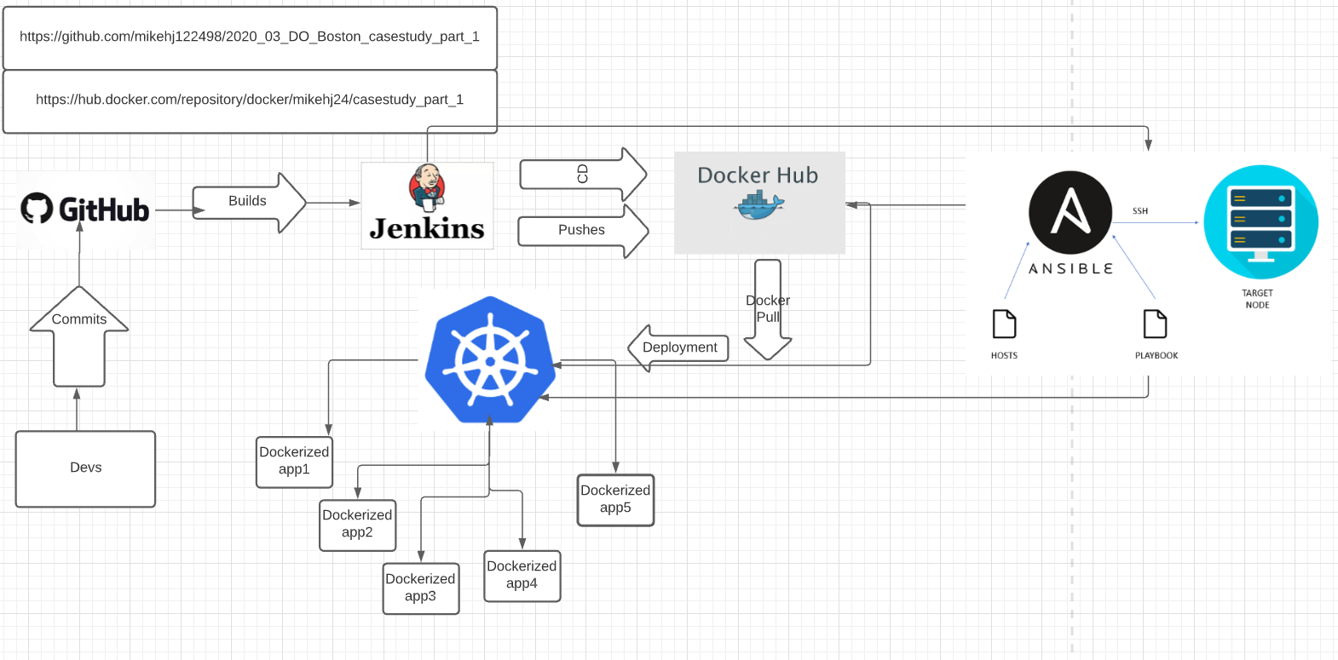

Slide 6
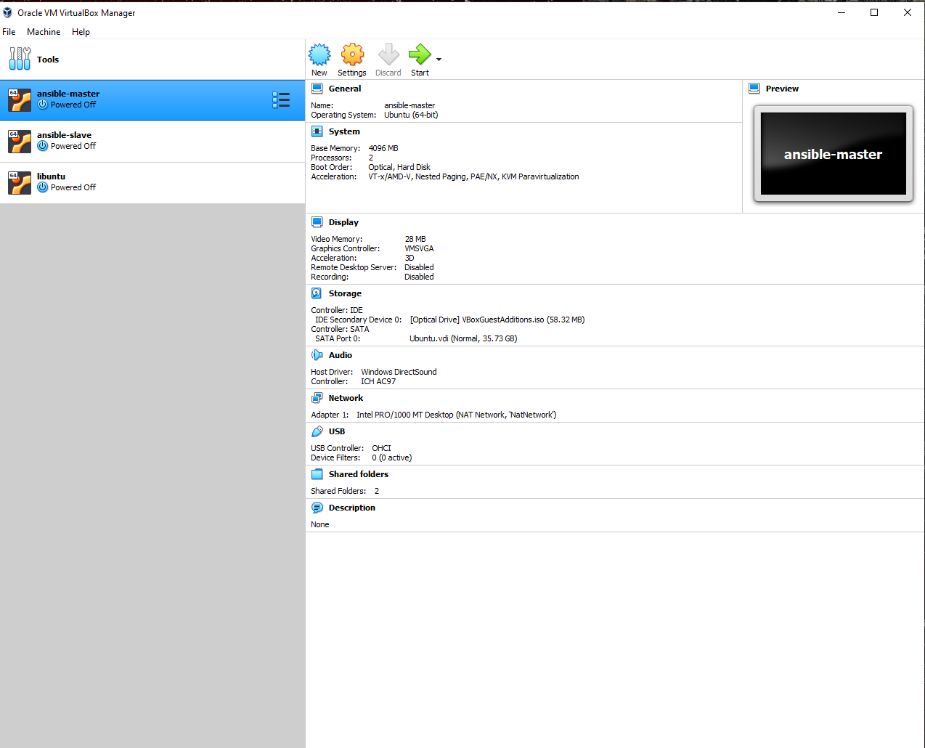

Slide 7
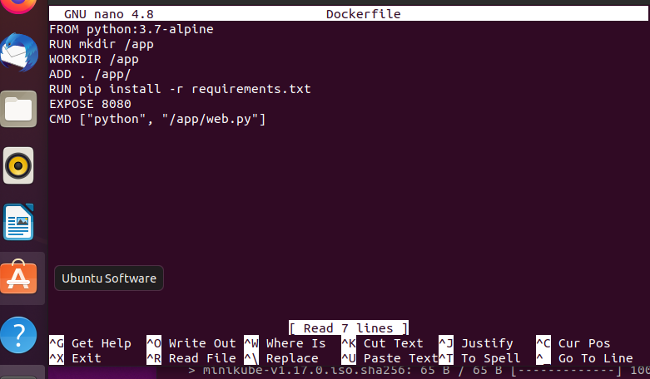

Slide 8
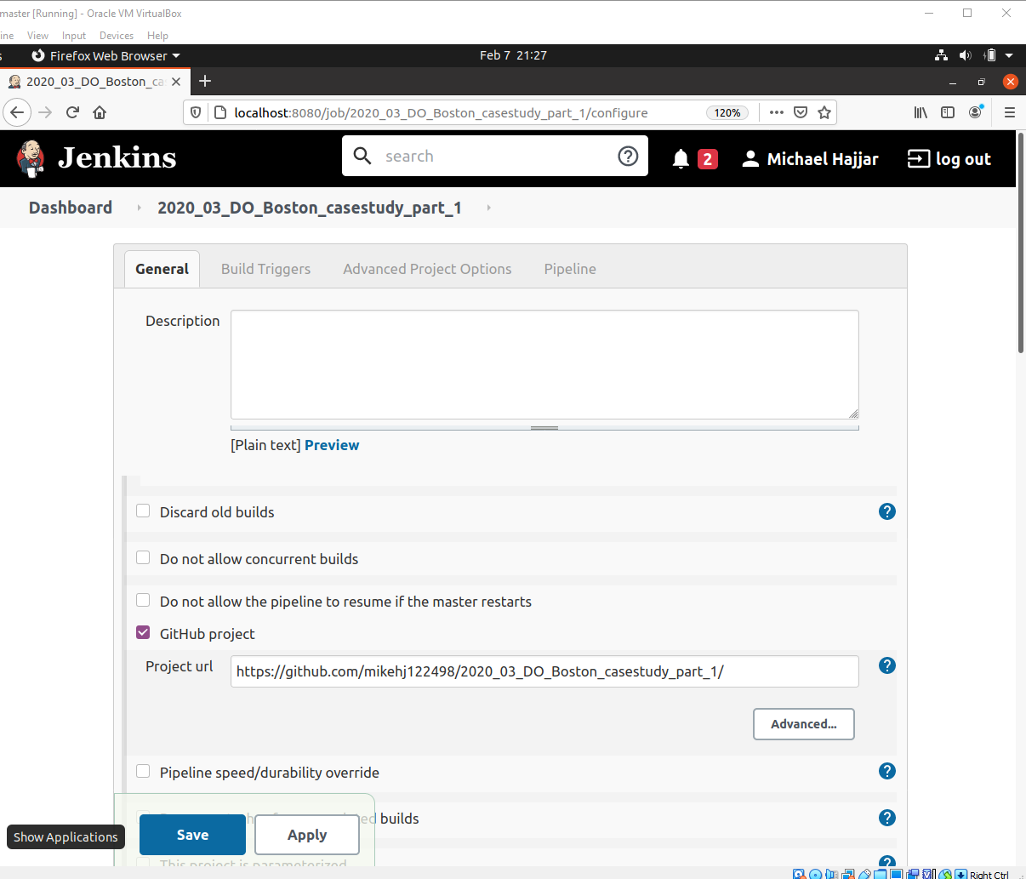

Slide 9
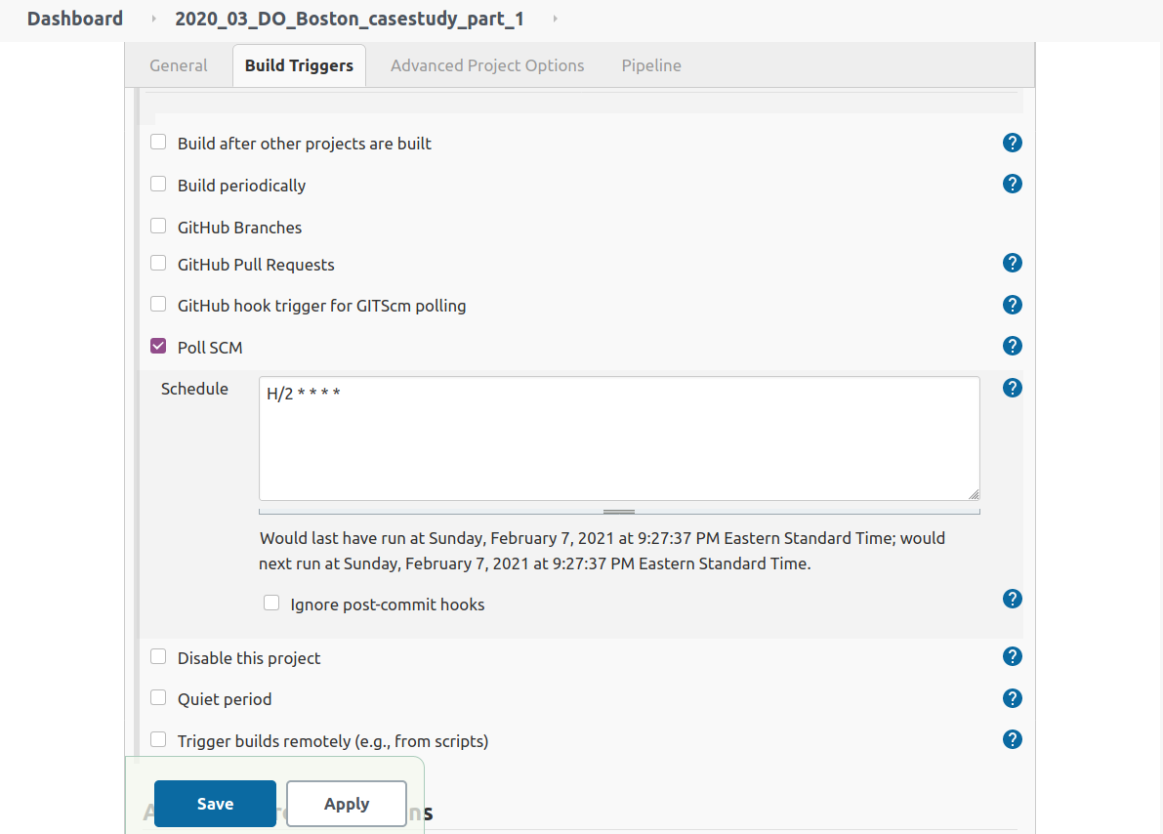

Slide 10
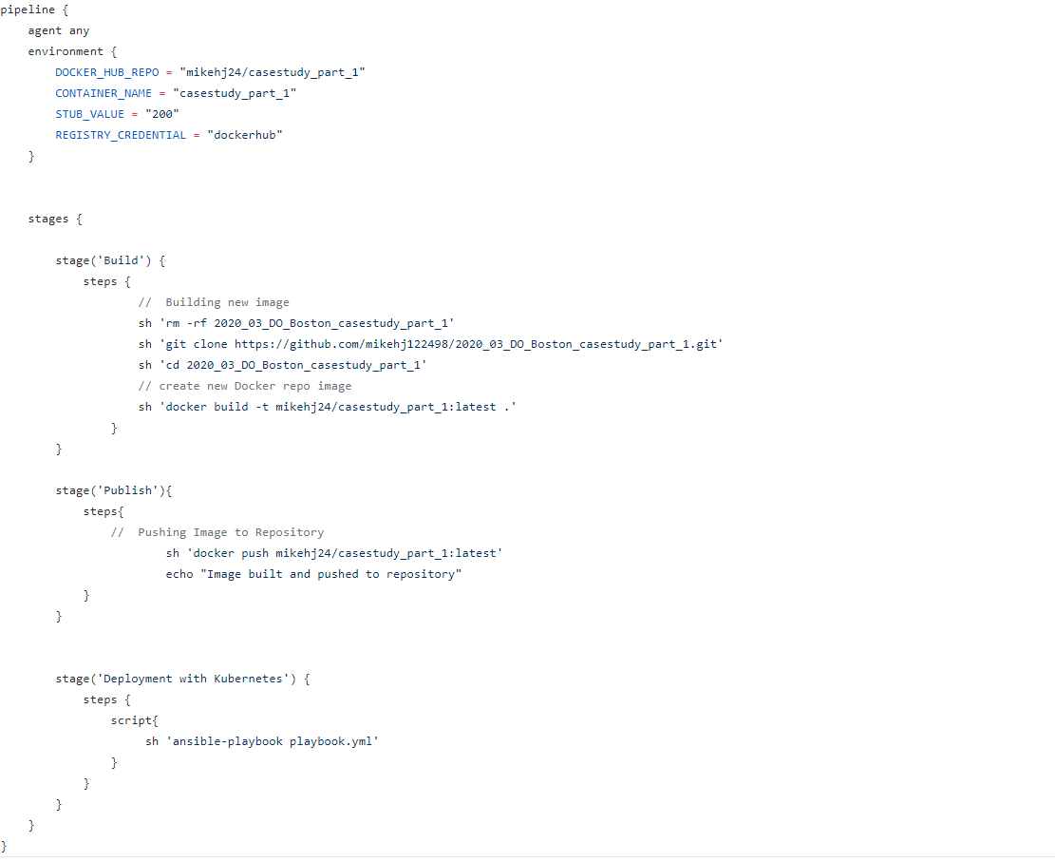

Slide 11
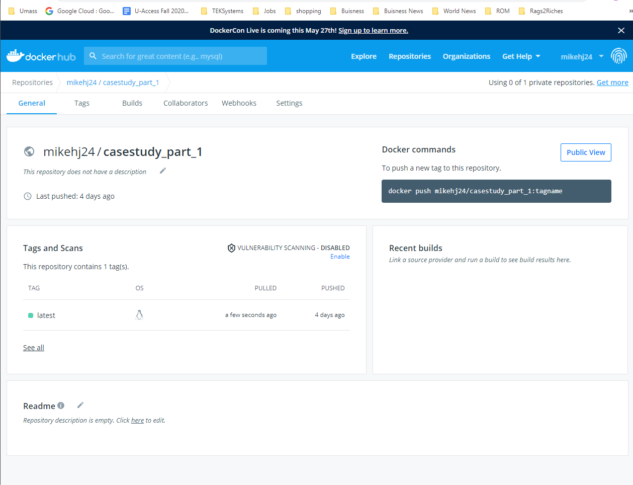

Slide 12
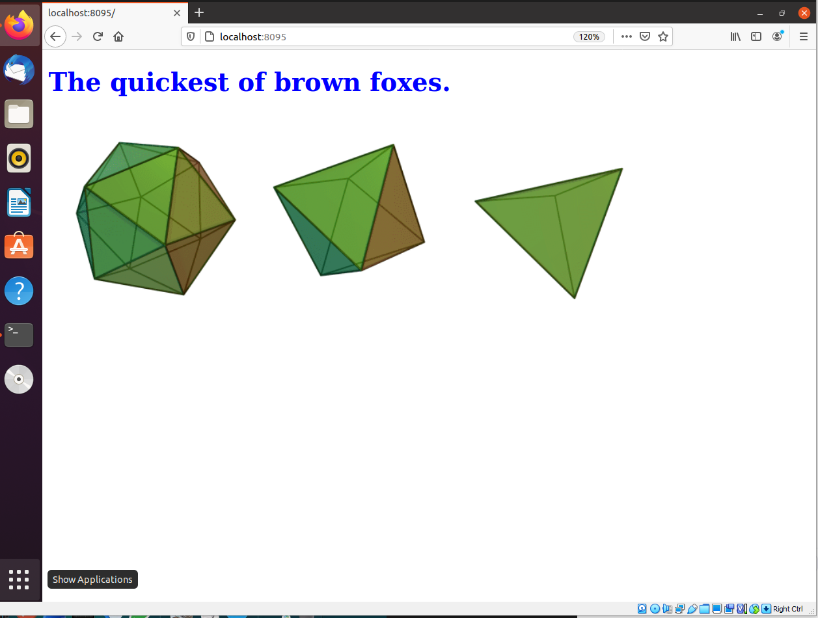

Slide 13
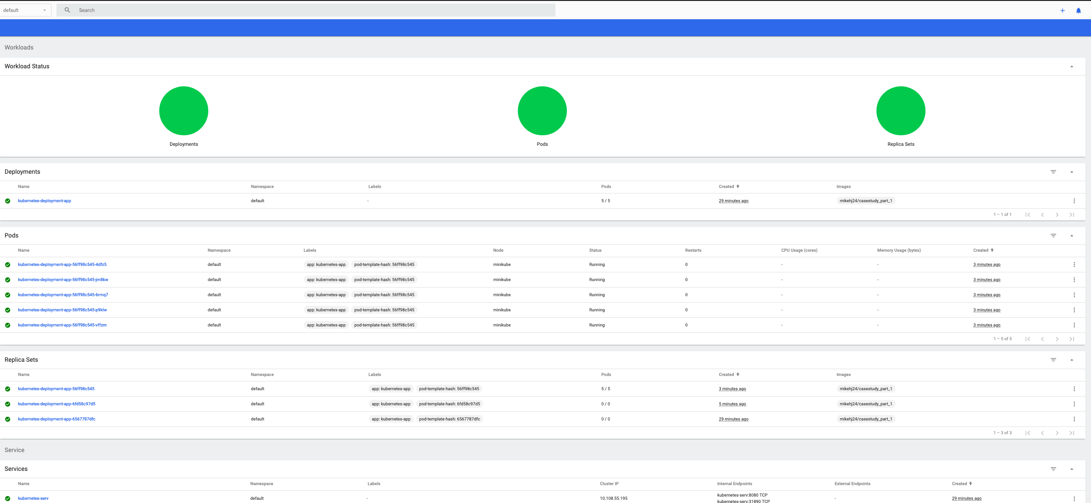

Slide 14
How far did I get
Minikube started to have hardware limitations in implementing kubernetes cluster
Struggled with ansible -playbook

Slide 15



Things that could have been better
AMD Ryzen 3 3200G X Intel Core i5-8th gen
“Sick of being Sick”

Slide 16

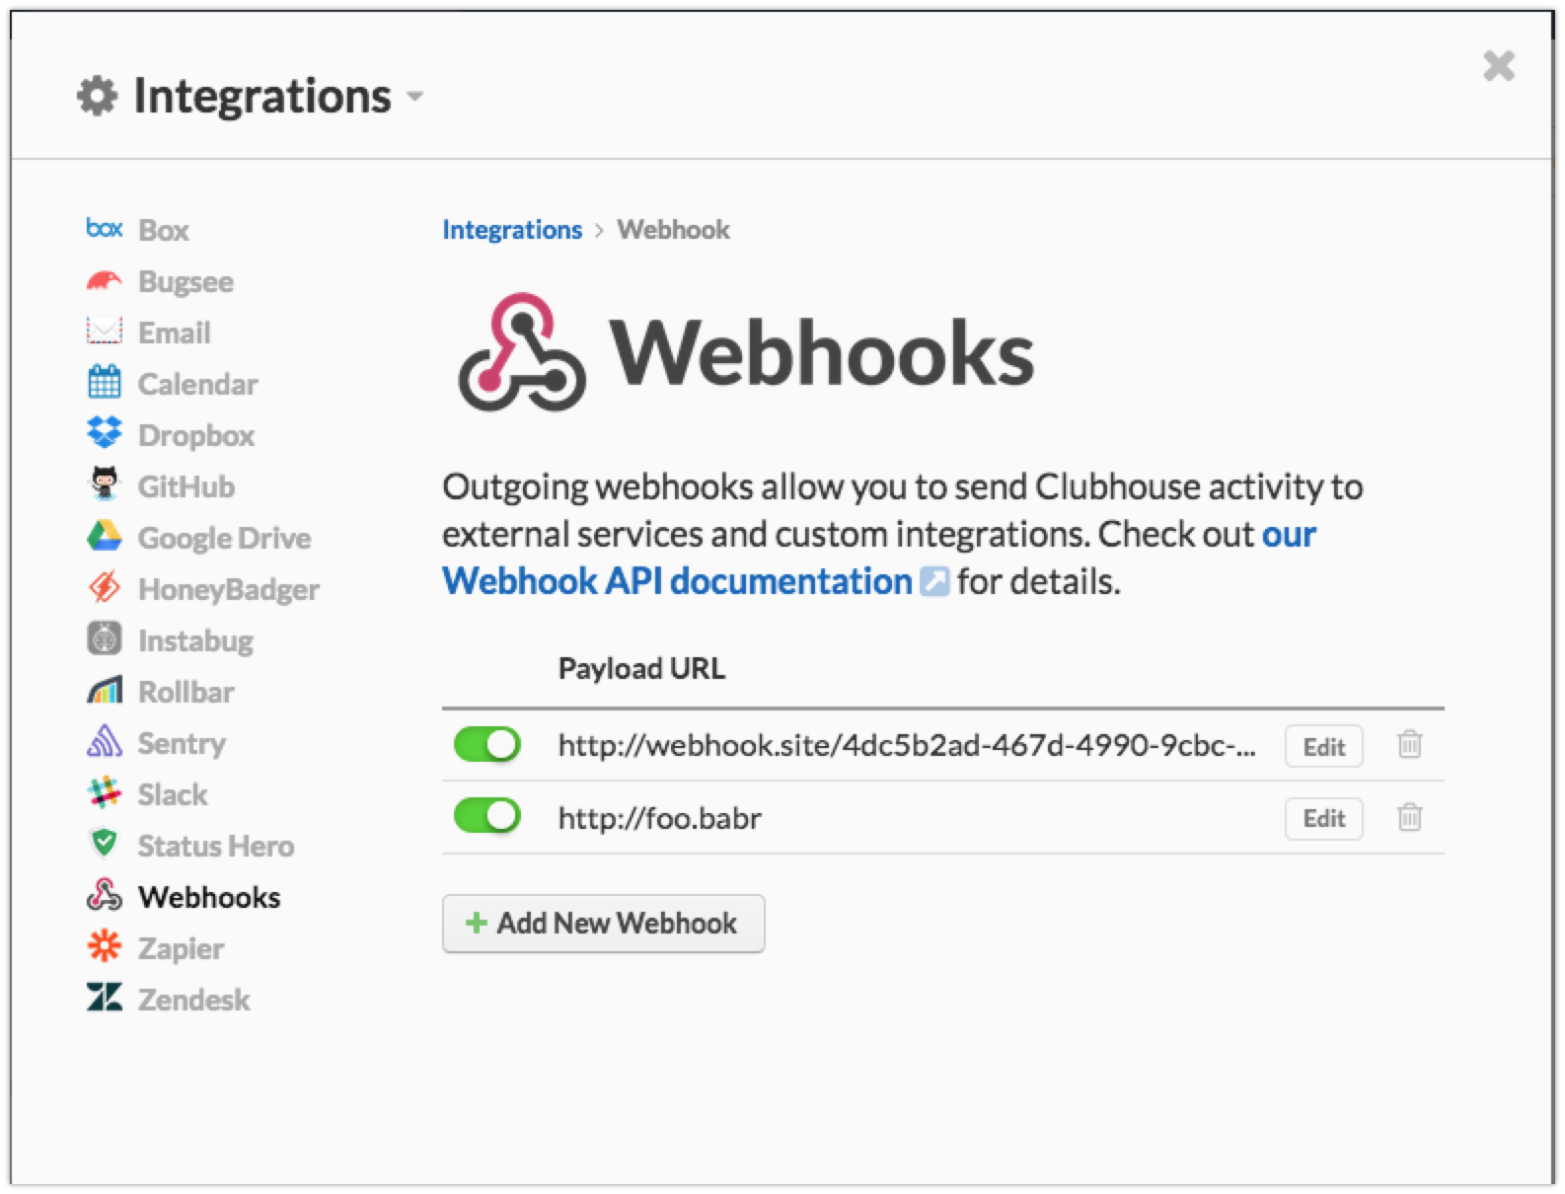
Things that could have been better part 2

Slide 17
The End
Thank You for watching!

